Slide 1

COVID-19 DATA ANALYTICS DASHBOARD

Slide 2

Name: Aditi Rana
Class: BCA 5th semester
Roll Number-: 190014045021
Submitted to: Er. Chandrabhan Singh
Institute: University of Lucknow

Slide 3
INDEX
Introduction
Objective
Requirement Specification
Modules
Features of Modules used
E-R diagram
Screenshots
Future Scope of the Project

Slide 4
About Organization
Digipodium is a platform which reaches out to its audiences to help them enrich their lives in a bigger and better manner through specializations in various of IT TRAINING & EDUCATION,DIGITAL MARKETING,EVENT MANAGEMENT, We are here to ensure some of the finest services in a most organized and systematic manner. We take pride in hosting a highly dedicated and confident staff which is committed to deliver, and takes up challenges, by updating themselves on the latest technologies.
Areas of Expertise
IT Training wing provides you specialized training programs mapped with the International Certification of Global Giants like Oracle, Microsoft, Google, IBM etc. Training Programs are available on latest version of Data Analytics, Java, Advanced Java, Python, Django, Android, Kotlin, IoT, Machine Learning, Advanced Machine Learning, Big Data, PHP, Advanced PHP, Angular, .NET, Cloud etc. We suggest specialized training programs for students, which conform with industry requirements. This assists our young students to stay on top of emerging trends which are in sync with career opportunities which are rife and continuously growing. Our Key Resource Persons have dependable & experienced backgrounds in their respective areas of expertise. Their colossal bank of knowledge is endorsed with International Certifications and speak of their authenticity and authority.
The Digital Marketing team provides two broad services –
Digital Marketing Training
Digital Marketing Solution
Digital Marketing Training has programs from Associate Level to Master Level. All programs are mapped with Google and HubSpot Certifications. Training Programs are available on latest content of Digital Marketing Master Training Program, Online Advertising Using GOOGLE ADS, Search Engine Optimization (SEO), Web Analytics Using GOOGLE Analytics, Social Media Marketing (SMM), Content Marketing etc. Customized programs are available for students and professionals as per their requirement. Our Digital Marketing Solution team is here to provide solutions to corporates, small businesses, startups etc., related to online promotion and optimization techniques. Our key resource person is a Google and HubSpot Certified Digital Marketing Professional.

Slide 5
Introduction
Coronaviruses are a large family of viruses which may cause illness in animals or humans. In humans, several coronaviruses are known to cause respiratory infections ranging from the common cold to more severe diseases such as Middle East Respiratory Syndrome (MERS) and Severe Acute Respiratory Syndrome (SARS). The most recently discovered coronavirus causes coronavirus disease COVID-19 - World Health Organization
The number of new cases are increasing day by day around the world. This dataset has information from the states and union territories of India at daily level.
State level data comes from Ministry of Health & Family Welfare
Testing data and vaccination data comes from covid19india. Huge thanks to them for their efforts!
Update on April 20, 2021: Thanks to the Team at ISIBang, I was able to get the historical data for the periods that I missed to collect and updated the csv file.
Content
COVID-19 cases at daily level is present in covid_19_india.csv file
Statewise testing details in StatewiseTestingDetails.csv file
Travel history dataset by @dheerajmpai - https://www.kaggle.com/dheerajmpai/covidindiatravelhistory
Acknowledgements
Thanks to Indian Ministry of Health & Family Welfare for making the data available to general public.
Thanks to covid19india.org for making the individual level details, testing details, vaccination details available to general public.
Thanks to Wikipedia for population information.
Thanks to the Team at ISIBang
Photo Courtesy - https://hgis.uw.edu/virus/
Inspiration
Looking for data based suggestions to stop / delay the spread of virus

Slide 6
OBJECTIVE
To analyse the statewise vaccination.
To visualize the vaccination of people individually in a state with the help of graphs and plots.
The COVID Tracking Project collects and publishes the most complete testing data available for INDIA.

Slide 7
REQUIREMENTS SPECIFICATIONS
Hardware requirements
I3,i5 intel processor
8 GB RAM
216 GB HDD
Colour monitor
Keyboard, mouse
Software Requirements
Python 3 (Any version)
Visual Studio Code(VSC)
Any browser(Google Chrome , Microsoft Edge)

Slide 8
MODULES
The system after careful analysis has been identified to be presented with the following modules.
COVID-19 Data Analytics Dashboard deals with the following modules:
NumPy
Pandas
DataFrames
Matplotlib
Streamlit
Seaborn

Slide 9
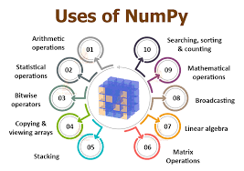
NUMPY LIBRARY
NumPy stands for Numerical Python.
NumPy is used for working with arrays.
NumPy aims to provide an array object that is up to 50x faster that traditional Python lists.
NumPy arrays are stored at one continuous place in memory unlike lists, so processes can access and manipulate them very efficiently.
It also has functions for working in domain of linear algebra, Fourier transform, and matrices.
NumPy was created in 2005 by Travis Oliphant. It is an open source project and you can use it freely.
Python we have lists that serve the purpose of arrays, but they are slow to process.
The array object in NumPy is called ndarray, it provides a lot of supporting functions that make working with ndarray very easy.
Arrays are very frequently used in data science, where speed and resources are very important.

Slide 10

PANDAS LIBRARY
Tools for reading and writing data between in-memory data structures and different formats.
Intelligent data alignment and integrated handling of missing data.
Aggregating or transforming data with a powerful group by engine allowing split apply-combine operations on data sets.
High performance merging and joining of data sets.
Columns can be inserted and deleted from data structures for size mutability
Data cleansing
Data fill
Data normalization
Merges and joins
Data visualization
Statistical analysis
Data inspection
Loading and saving data And much more

Slide 11
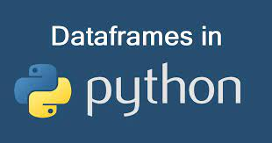
DATAFRAMES
DataFrame is a 2-dimensional labeled data structure with columns of potentially different types.
It is like a spreadsheet or SQL table, or a dictionary of Series objects.
It is generally the most commonly used pandas object.
Like Series, DataFrame accepts many different kinds of input.
DataFrames in Python are very similar: they come with the Pandas library, and they are defined as two-dimensional labeled data structures with columns of potentially different types.
In general, you could say that the Pandas DataFrame consists of three main components: the data, the index, and the columns.

Slide 12
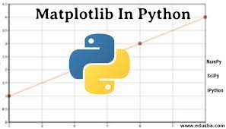
MATPLOTLIB
Matplotlib is a low level graph plotting library in python that serves as a visualization utility.
Matplotlib was created by John D. Hunter.
Matplotlib is open source and we can use it freely.
Matplotlib is mostly written in python, a few segments are written in C, Objective-C and Javascript for Platform compatibility.t first sight, it will seem that there are quite some components to consider when you start plotting with this Python data visualization library. You’ll probably agree with me that it’s confusing and sometimes even discouraging seeing the amount of code that is necessary for some plots, not knowing where to start yourself and which components you should use.

Slide 13

STREAMLIT
Streamlit is an open-source python framework for building web apps for Machine Learning and Data Science. We can instantly develop web apps and deploy them easily using Streamlit. Streamlit allows you to write an app the same way you write a python code. Streamlit makes it seamless to work on the interactive loop of coding and viewing results in the web app. Data flow Streamlit allows you to write an app the same way you write a python code. The streamlit has a distinctive data flow, any time something changes in your code or anything needs to be updated on the screen, streamlit reruns your python script entirely from the top to the bottom. This happens when the user interacts with the widgets like a select box or drop-down box or when the source code is changed.
If you have some costly operations while rerunning your web app, like loading data from databases, you can use streamlit’s st@cache method to cache those datasets, so that it loads faster.
Streamlit runs the python script from top to bottom
Each time the user interacts the script is a rerun from top to bottom
Streamlit allows you to use caching for costly operations like loading large datasets.

Slide 14
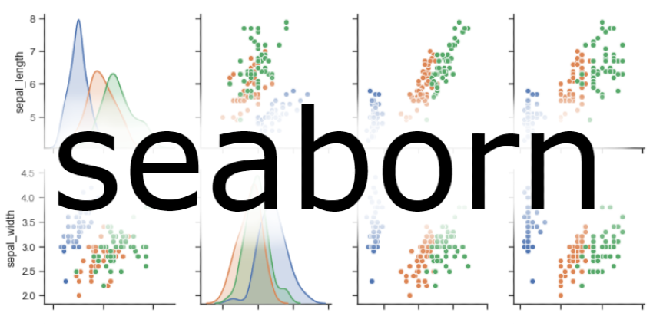
SEABORN
Seaborn is an open-source Python library built on top of matplotlib. It is used for data visualization and exploratory data analysis. Seaborn works easily with dataframes and the Pandas library. The graphs created can also be customized easily. It provides a high-level interface for drawing attractive and informative statistical graphics. Seaborn helps you explore and understand your data. Its plotting functions operate on dataframes and arrays containing whole datasets and internally perform the necessary semantic mapping and statistical aggregation to produce informative plots. Its dataset-oriented, declarative API lets you focus on what the different elements of your plots mean, rather than on the details of how to draw them

Slide 15
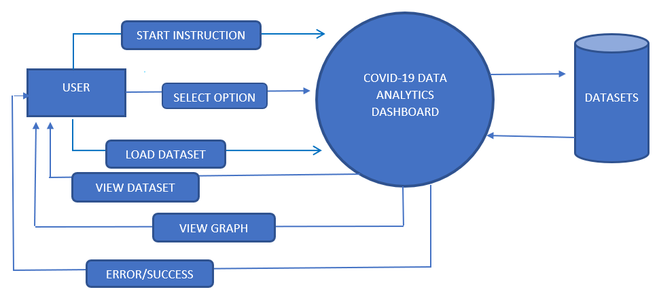
DATA FLOW DIAGRAM

Slide 16
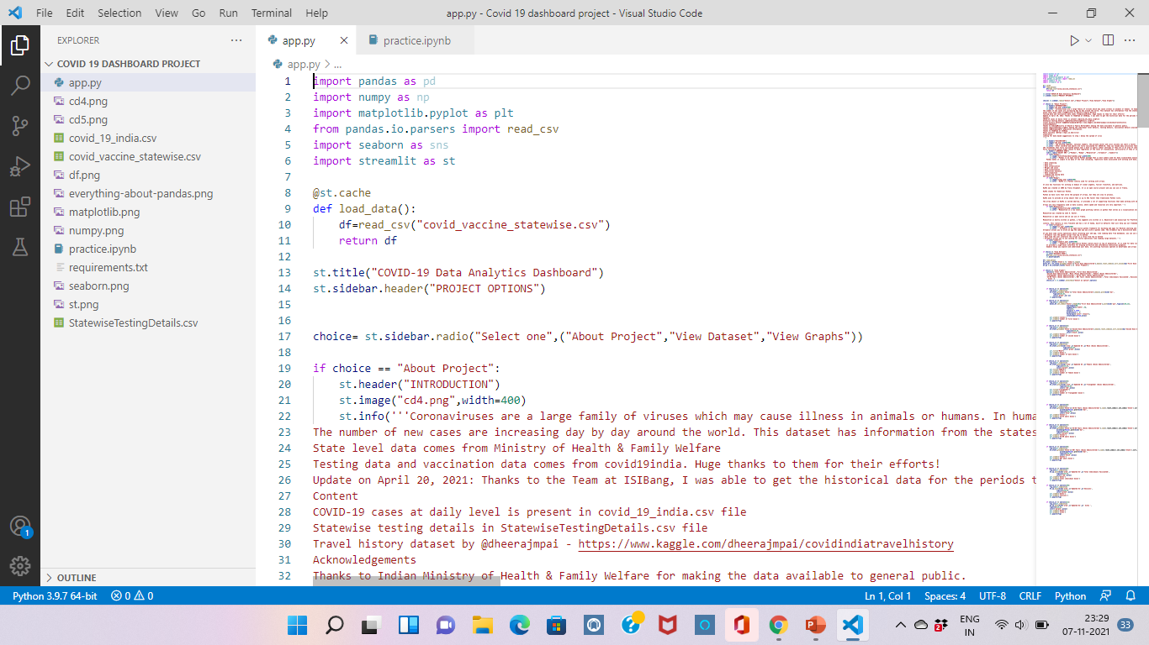
SCREENSHOT-1

Slide 17
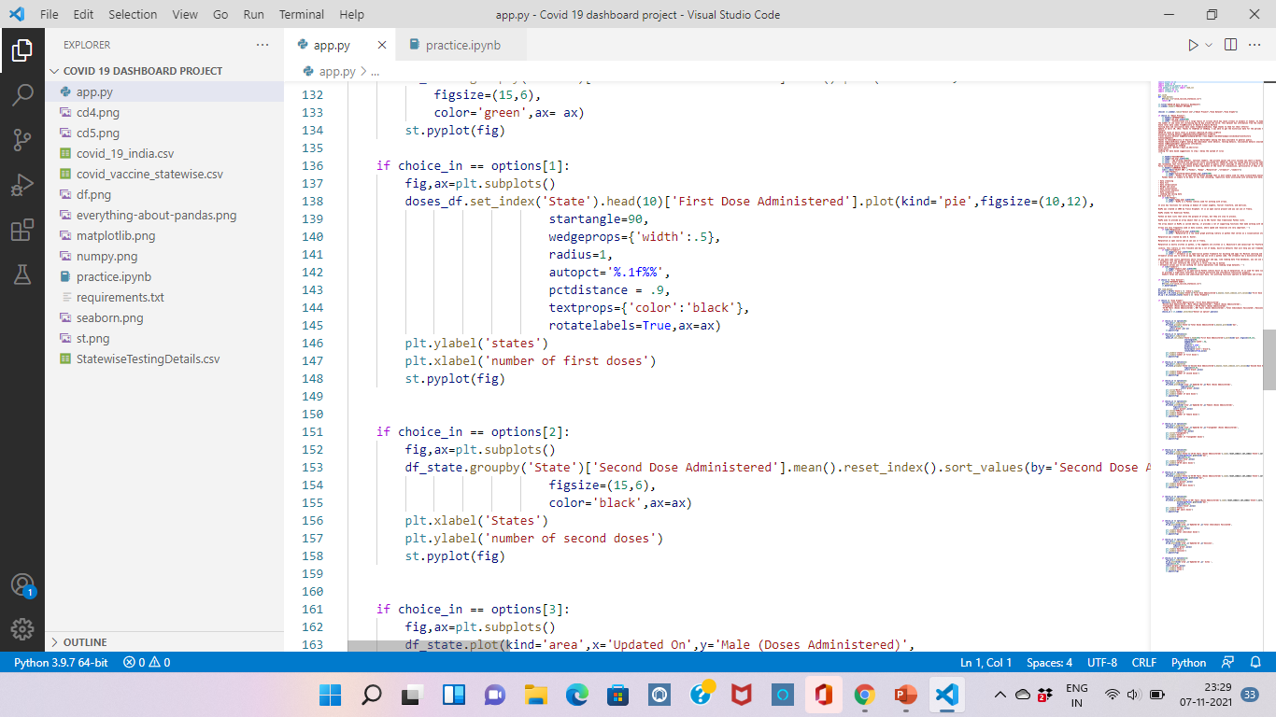
SCREENSHOT-2

Slide 18
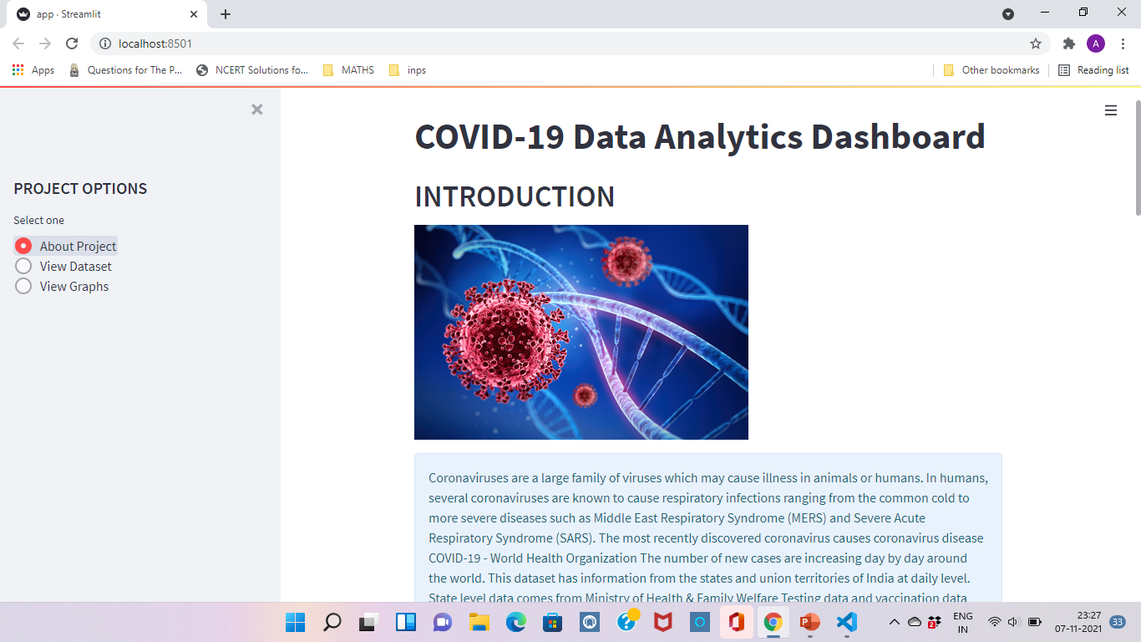
SCREENSHOT-3

Slide 19
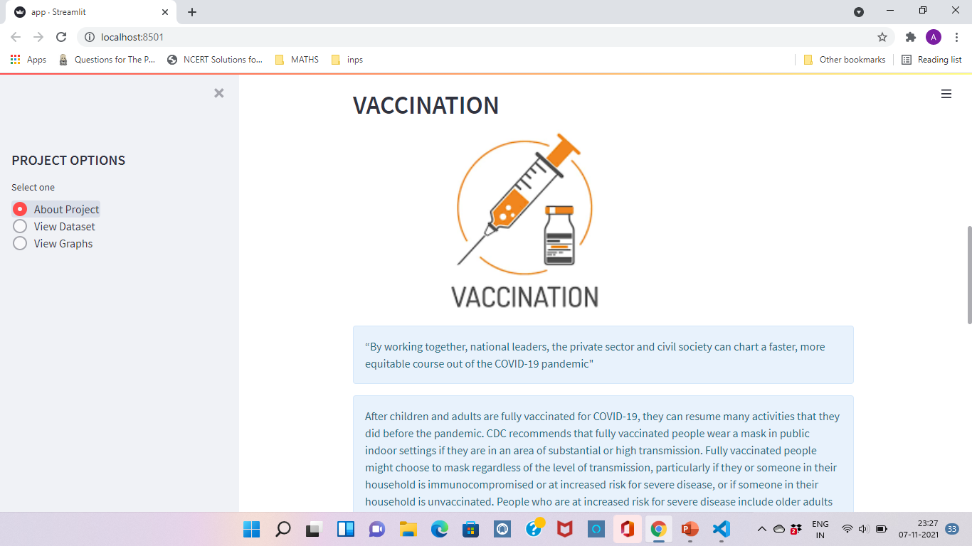
SCREENSHOT-4

Slide 20
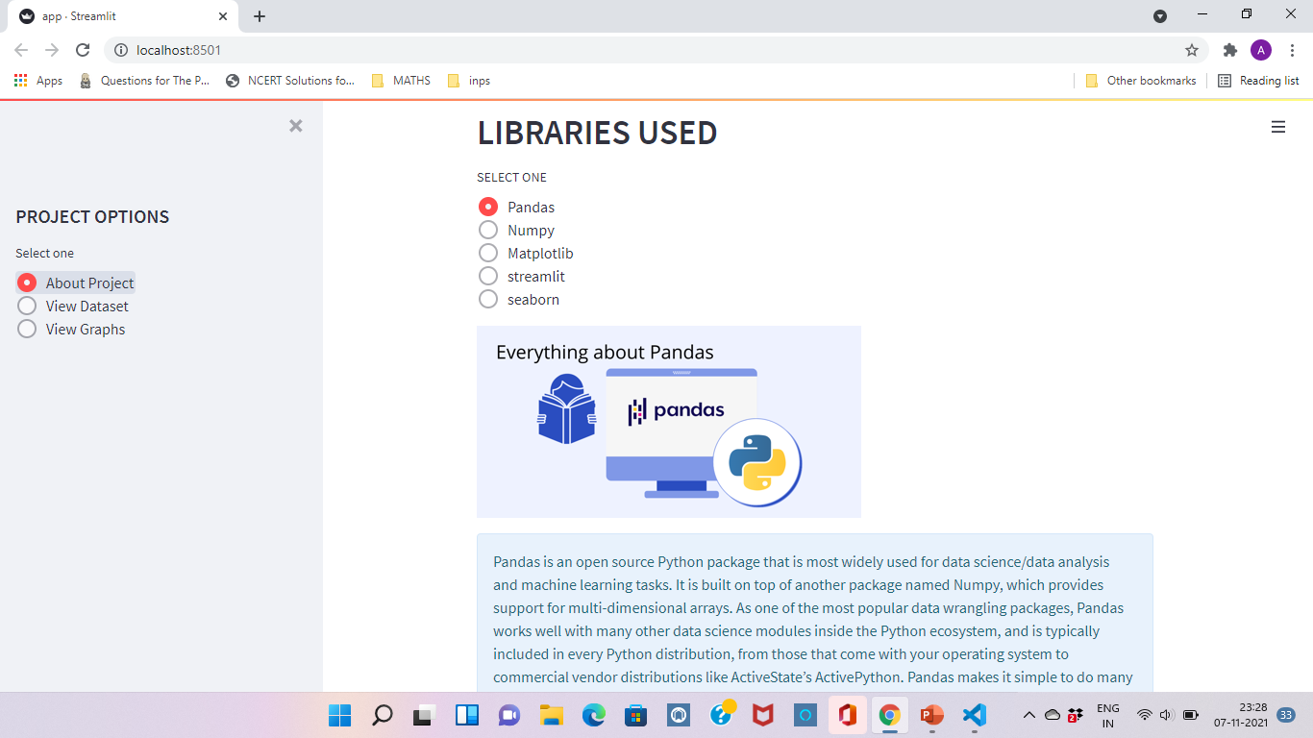
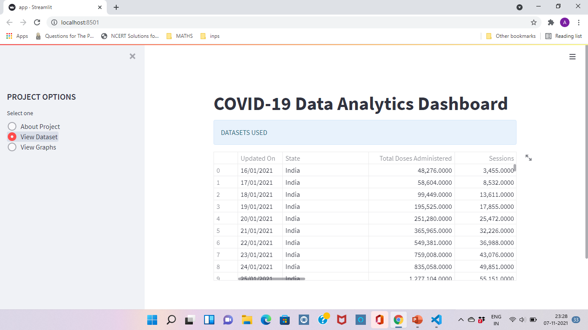
SCREENSHOT-5

Slide 21
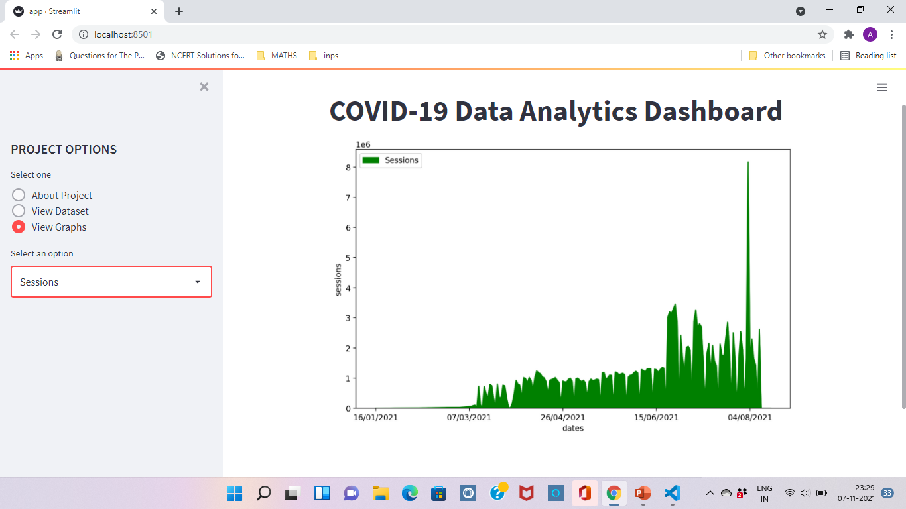
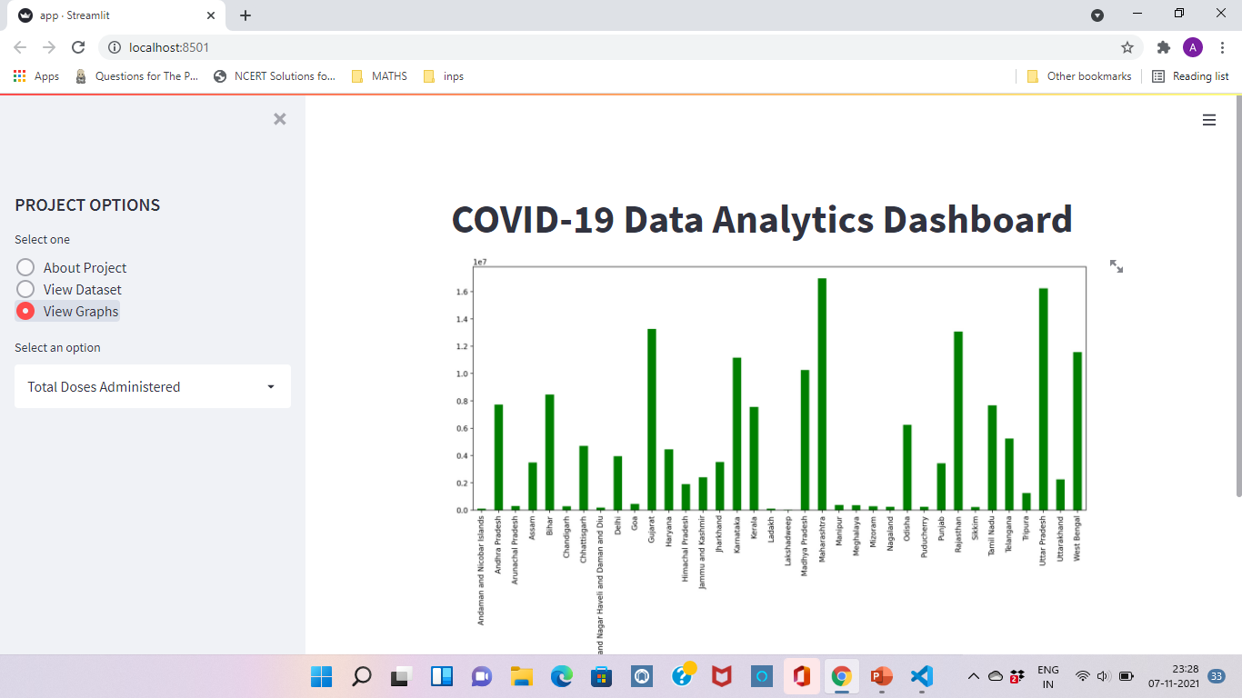
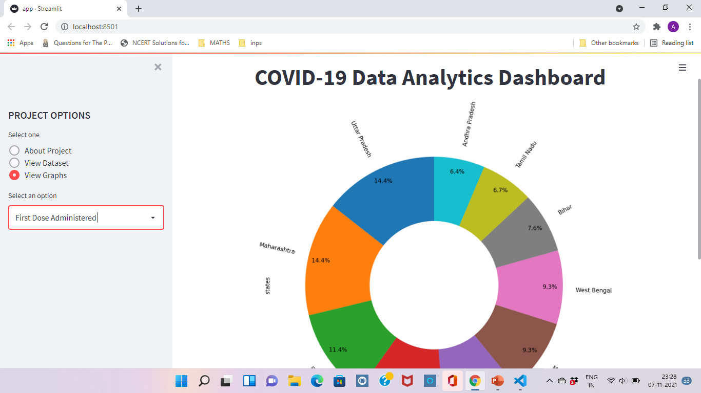
SCREENSHOT-6

Slide 22
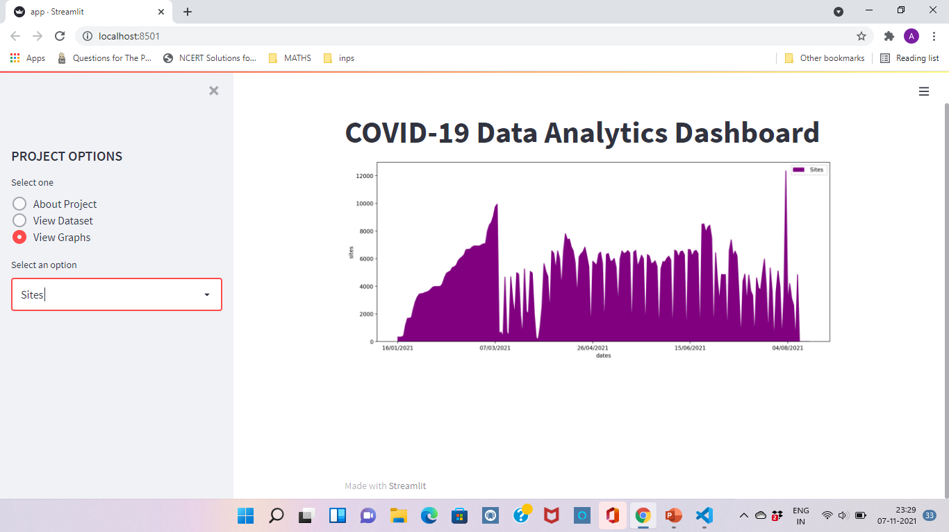
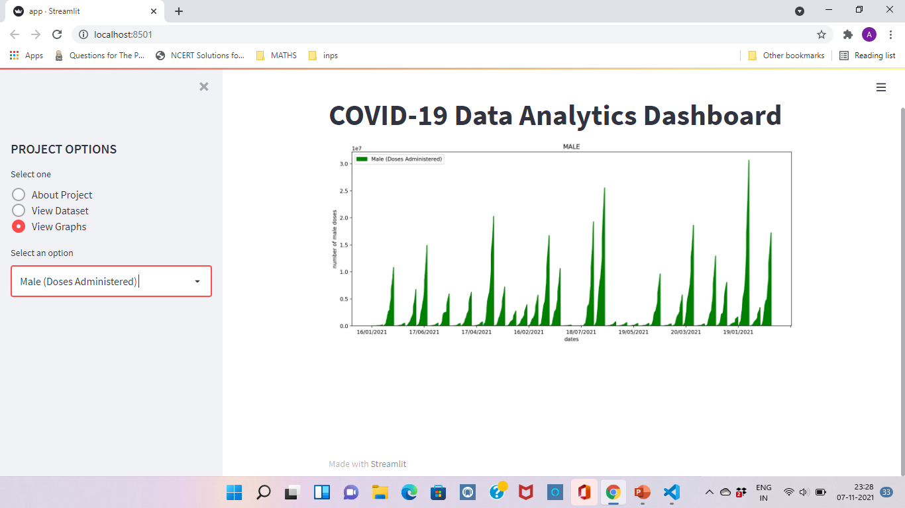
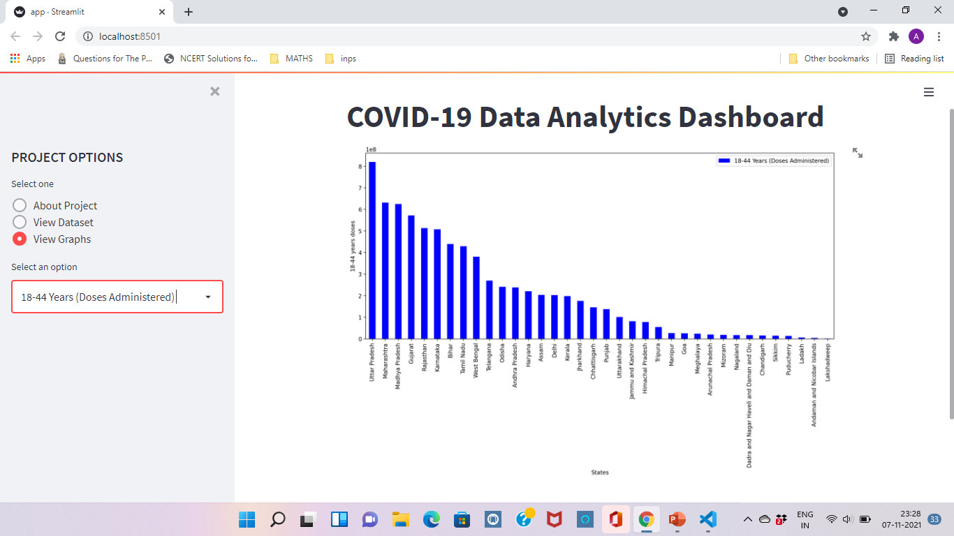
SCREENSHOT-7

Slide 23
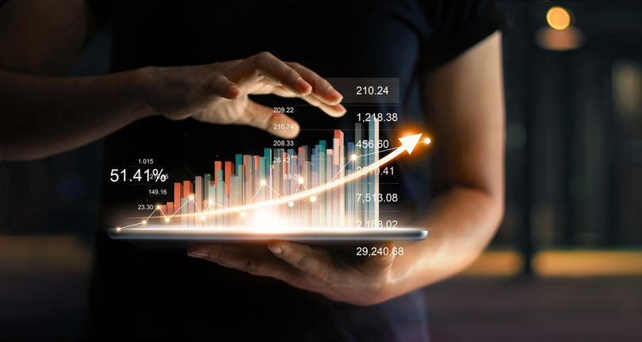
FUTURE SCOPE OF THE PROJECT
The power, scope, and scale of both technology and data collection has been growing exponentially. The potential for business dashboards is sky high. Business dashboard tools in the future are likely to incorporate machine learning and AI so they can bubble up points of interest and identify patterns in raw data that even the most well equipped data scientist will not be able to find manually.
I for one, welcome the formatting of my A.I. overlords.
It’s clear that there’s a trend in bringing wider access to more people as well as to organizations previously too small to use legacy systems. Moving forward, balancing access with functionality will be the challenge facing the industry.
COVID-19 DATA ANALYTICS DASHBOARD is used to analize the covid cases in the entire world and also to check the vaccination of people around the world and help the government to take the appropriate measures and future planning.
Big data analytics is on the verge of a major transformation. Many of the up-and-coming data analytics trends are the result of multiple “transformative” technologies converging at once.

Slide 24
THANK YOU

